Slide 1

Decentralisation
The blockchain and Ethereum development fundamentals
By Josh Stevens

Slide 2
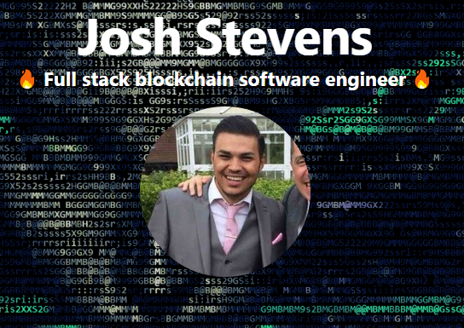
TypeScript, .NET Core, Angular, Solidity, SQL, Node, JavaScript & AWS developer
Got into blockchain in early 2017
Holder and investor of cryptocurrency
GitHub - https://github.com/joshstevens19
Work for a blockchain company called FunFair
I used to work at CloudCall
:wq

Slide 3

Who I work for?
The first decentralised gambling software
Runs from Ethereum smart contracts
40 Employees
Owned by OBE Jez San
Raised 26 million dollars in the ICO, which sold out in 4 hours
6 months later the 26 million was worth 156 million dollars due to the price of ETH raising
Frontend written in angular 6
Backend written in .NET Core and a little bit of node
Use SQL Server to hold some data (most is embedded in the blockchain)
Contracts written in solidity

Slide 4
What’s FunFairs aim to achieve
1 click casino setup
This means anyone can be a casino operator
Instant funds paid straight in your wallet
If you don’t know operators now can hold wins and make it very hard for you to get a big win paid out
Funds never out of your control, an escrow game smart contract holds the wallets and pays out the winner which are defined by a set of rules
Make every game open source
Be completely transparent with the maths behind the game
Currently the traditional operators' games are hosted on a big black box which could be doing anything (if (winnings > 40) return false)
Trustless
Client does not trust the server
Server does not trust the client
This makes it none bias
Complete transparency, everything is viewable on the blockchain
If the operator can’t afford the max return the operator will not be allowed to open a game with the player
This is something which again can happen in the traditional operators

Slide 5
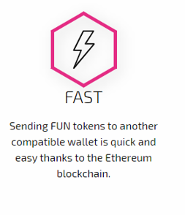
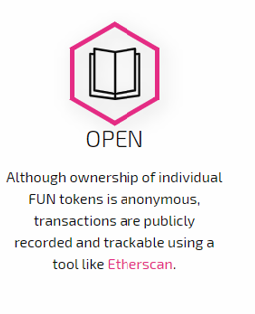
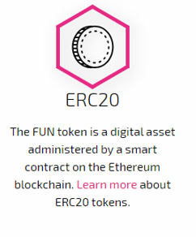
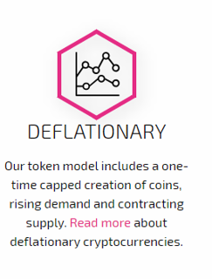
What does the FUN token do?
“FUN is the native digital token which powers every aspect of the FunFair gaming ecosystem. It is the betting chip that pits player against casino, the financial reward paid to developers for their games and the fuel that enables key processes on the network.”

Slide 6
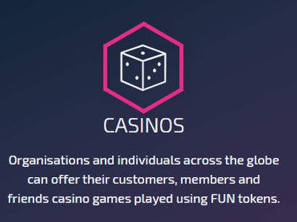
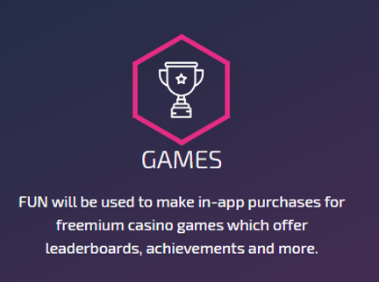
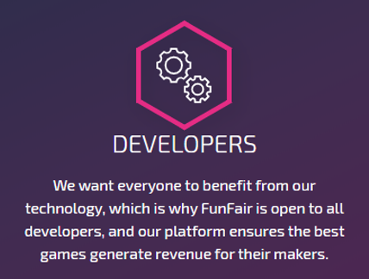
How FUN will be used

Slide 7
Back to simple talk…What is the blockchain?
“A digital ledger in which transactions made in bitcoin or another cryptocurrency are recorded chronologically and publicly.”
Originally descripted in 1991 to timestamp digital documents so they could not be tamped with
This was never adopted
2009 Bitcoin used this same idea to create the digital currency Bitcoin
Basically a huge open source database
Everyone can see everything embedded in it
No bitcoin is not the only cryptocurrency which is used
Uses transaction blocks to store data
Each block is unique to itself
Nobody is in control or owns the data
Each transaction is a block
You must pay a fee to the miners to send your transaction which will be embedded in the blockchain
Reading data is free, it’s only writing which costs
All data is immutable

Slide 8
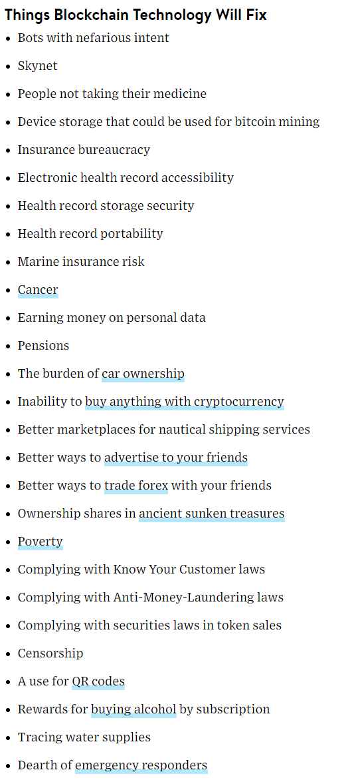
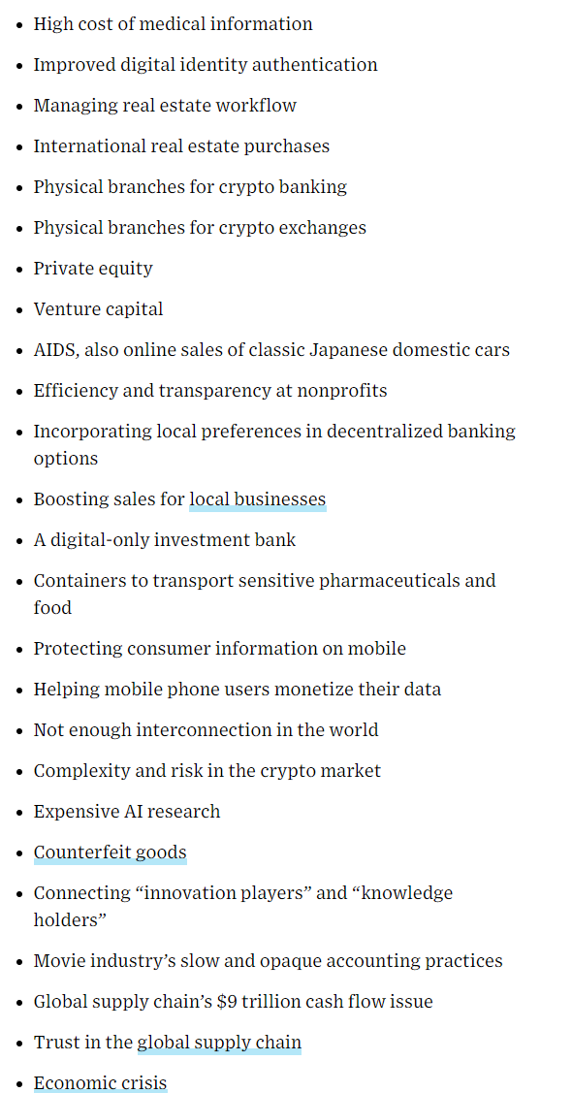
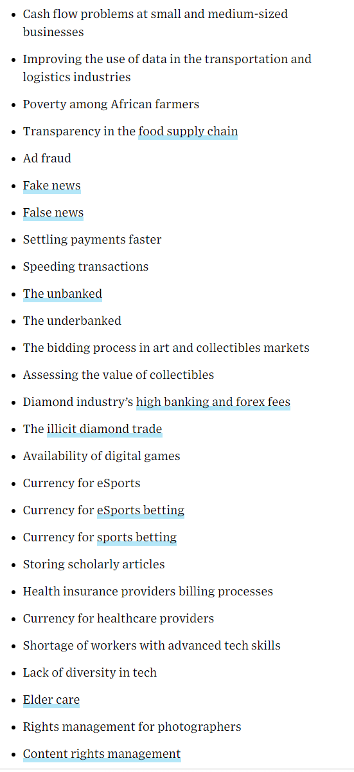
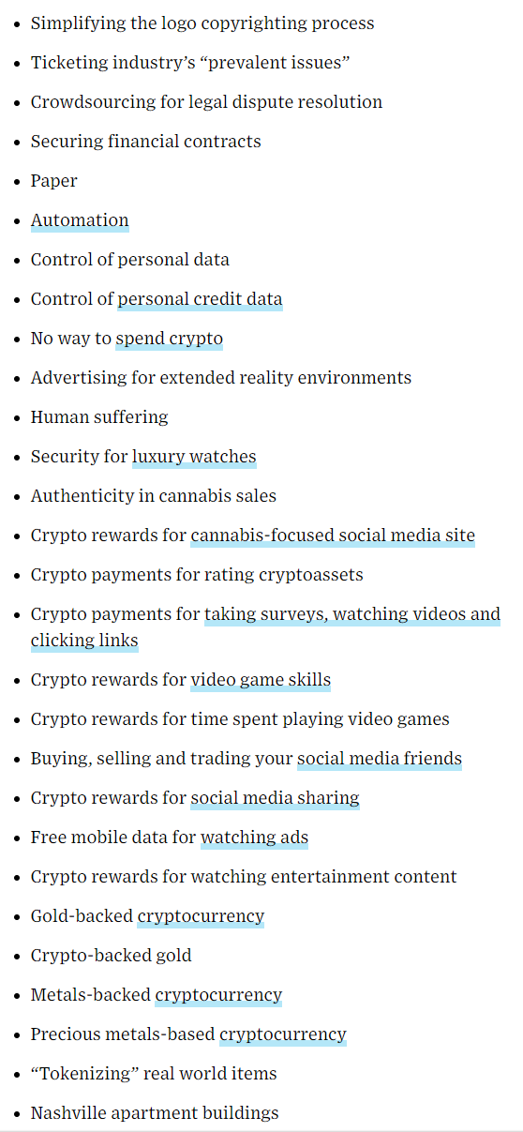
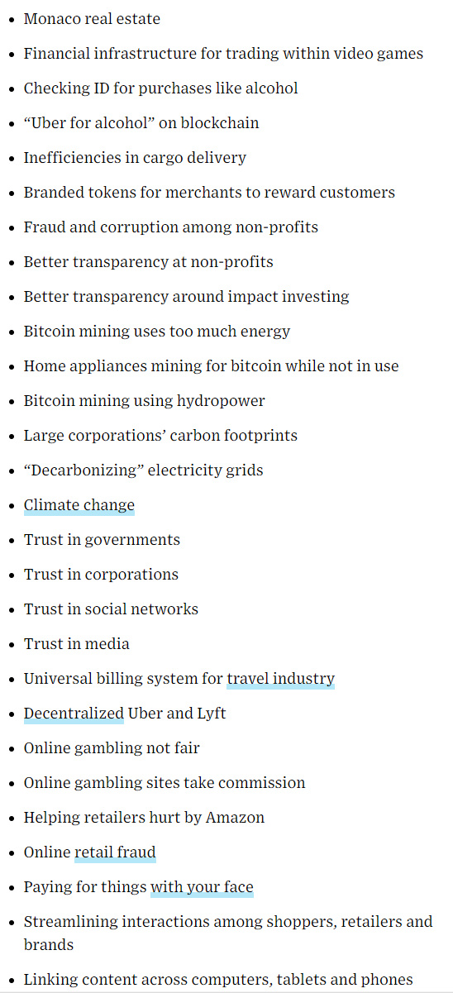
What does the blockchain solve?
A bank can lend up 12x as much as it has in its bank
12 TIMES !!
You are never in control of this money it’s just a digital value..
First came selling sheep, then gold, then money, then cards… what's next, something is always comes next…

Slide 9
The main thing..
TO PUT CONTROL BACK IN YOUR HANDS

Slide 10
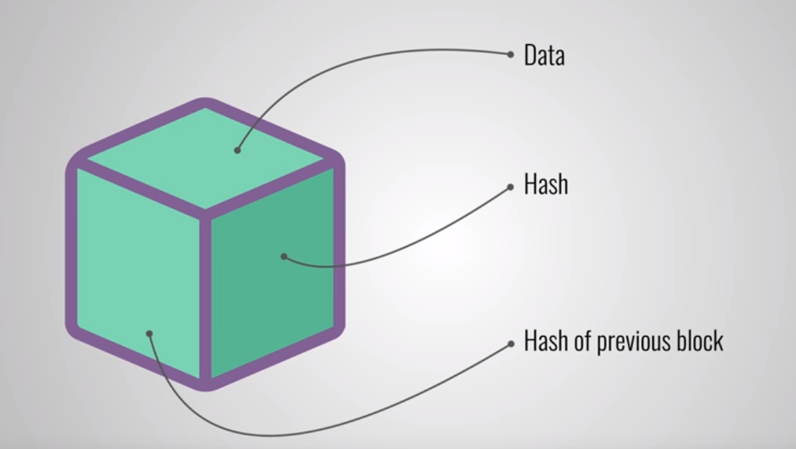
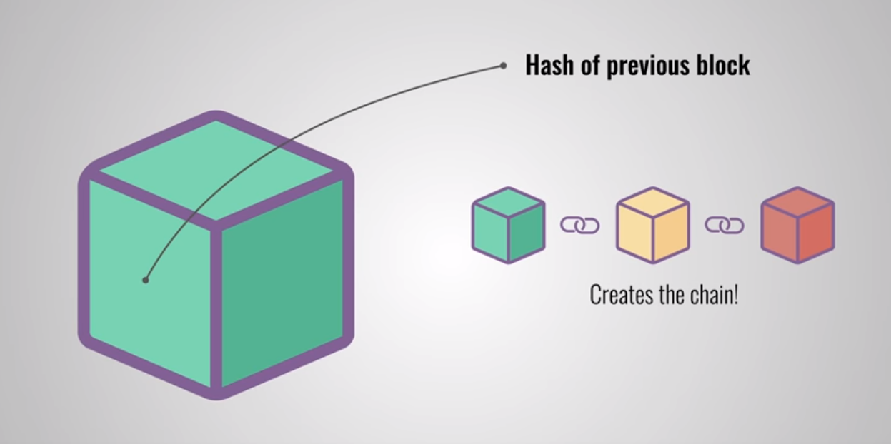
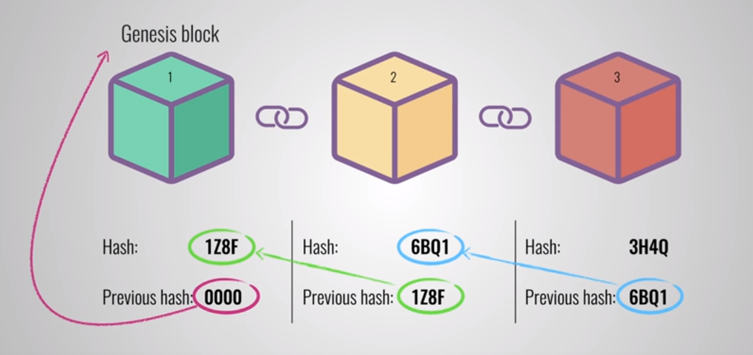
What does a block contain
Hash
is always unique
its identifiers a block and all its contents
Once a block has been created its hash as been calculated
Changing something inside the block will cause the hash to change

Slide 11
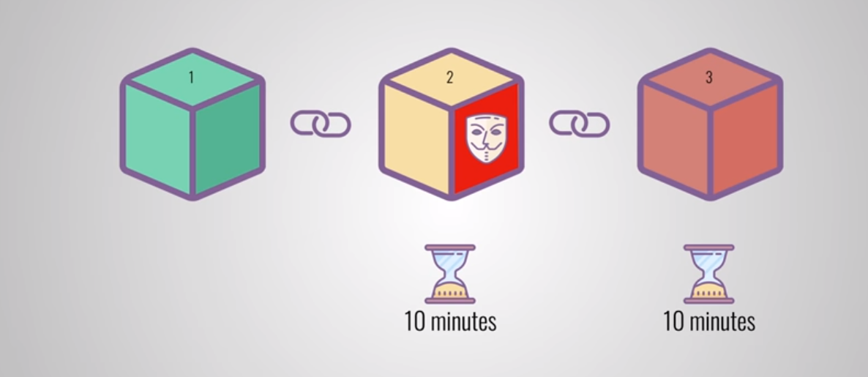
“Proof-of-work” - protection
Computers could calculate 100s of thousands of hashes a second
In theory you could tamper a block and all the other previous blocks to make the blockchain valid again
Proof-of-work stops this and slows down the creation of new blocks
In bitcoins case it takes 10 minutes to put it into the blockchain

Slide 12
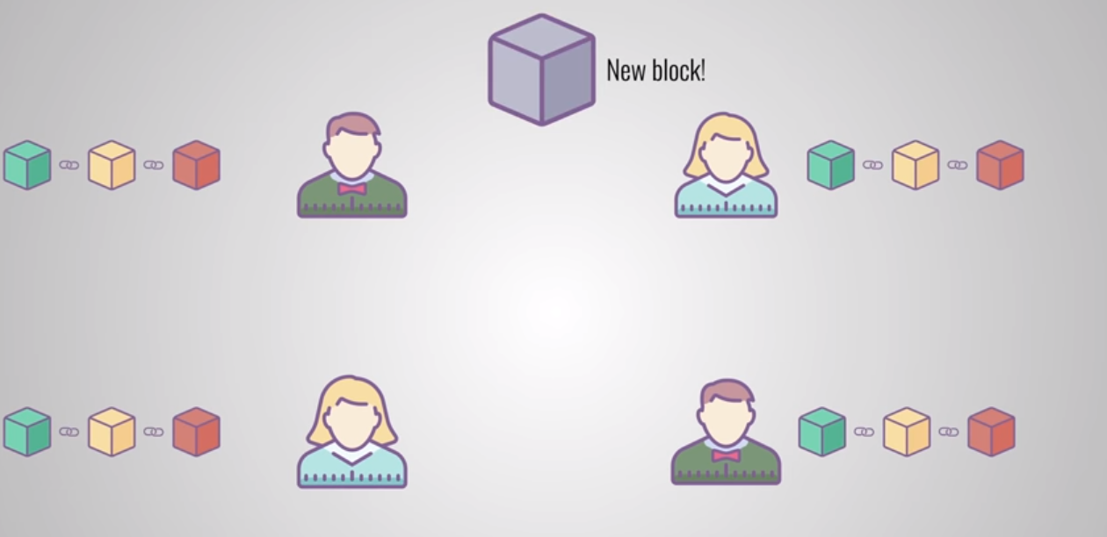
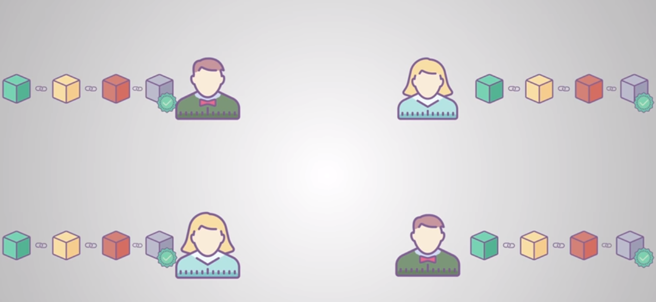
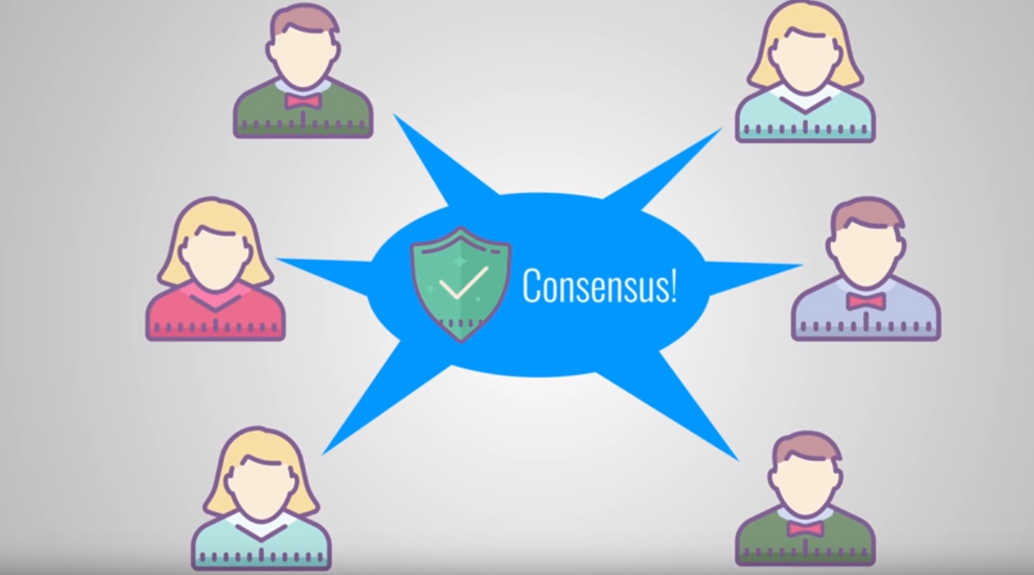
Peer 2 peer network
Sent to everyone on the network
Each node verifies the block to make sure that’s not been tampered with
Everything is correct each node adds the block to their own blockchain
They agree about what blocks are valid
Blocks which are tampered will be rejected by other nodes in the network
This makes it impossible to embed tampered blocks in the blockchain

Slide 13

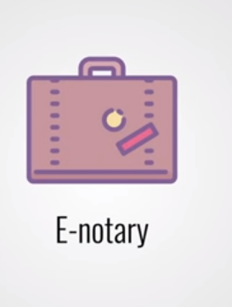
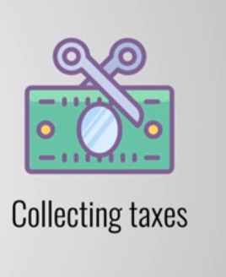
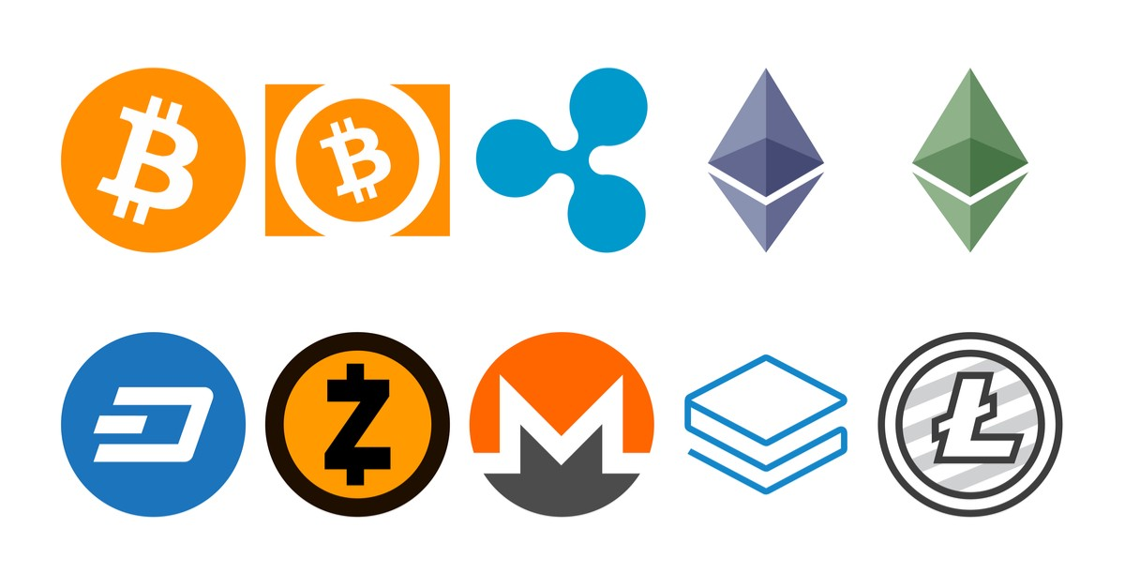
Projects ideas which are using the blockchain..
Was 800 billion 10 months ago ☹ (don’t panic )
Anything is possible with the blockchain, any idea in the world!!!

Slide 14
Things the blockchain needs to improve on to become mainstream..
Speed
Manipulation
Hacks
General view
Understand the benefits of using the blockchain
Big banks and social media companies to adapt
They are already but keeping it very quiet
Ease of development
Better UX/UI designs
Become less techy to understand
Price needs to become stable
Get rid of the “get rich quick” thinking
Community sharing code
People using it without knowing they are using it

Slide 15
Where does Ethereum come in..
Ethereum is an open-source, public, blockchain-based distributed computing platform and operating system featuring smart contract functionality
Allowing developers to create smart contracts which contain functionality
Written in GO, C++, Rust, Solidity
Smart contracts are written in Solidity
Everything on the Ethereum platform is paid for in ETH
Free to use
With the smart contracts it allows companies to create a decentralised project a lot easier
Ability to create your own utility token with its own identity

Slide 16
What happens when you send an Ethereum transaction
There are a lot of tokens built on top of Ethereum, each have their own logic to send and receive tokens within the smart contract
The sender pays a gas fee to the miners to move the tokens from his/her wallet to another
Once sent it goes into a “pool” off transaction and minors will pick and choose which ones will make them the most money (Gas fee)
Once a miner takes the transaction, they authenticate that it’s a valid transaction against their local node blockchain, this then gets confirmed this with the peer 2 peer network anywhere between 2 – 99+ times
At this point a block is created but not finalised into the master node until all confirmations are complete
Once confirmed by the minors the funds will now be in the receiver's address, it’s now embedded in the blockchain with a hash and a link to the last block. At this point this block and hash can never be changed
Blocks are never related to each other; all blocks are a singleton of itself.
That doesn’t mean someone could create functionality to link blocks together ;)
They only know about the last block hash, so it can form the `blockchain`

Slide 17
What is gas?
It measures how much work an action or set of actions takes to perform
Only operations which get embedded in the blockchain costs gas
Reading data is normally completely free (depending on how the smart contracts are written)
This helps to ensure an appropriate fee is being paid for operations hitting the network
This was done by design
By requiring a fee for an operation which needs to be performed means it does not get bogged down
It will only perform tasks that is valuable to someone (as people are paying!!)
Gas is a built-in token, it’s separate to Ethereum
But you can’t own x amount of gas tokens!
Gas only exists on the Ethereum virtual machines which indicates how much work is being performed
When it comes to paying gas the transaction fee is charged in Ethereum
The token is what is rewarded to miners for producing and verifying blocks
If your gas price is too low, no one will process your transaction
If your gas price is fine but the gas cost of your transaction runs "over budget" the transaction fails but still goes into the blockchain, and you don't get the money back for the work that the miners did.
Separate because Ethereum market rapidly change but the cost of calculations will not change if the market goes sky high or super low
Super important else every time the market changes executing operations would fluctuate in price
This makes sure that nothing runs forever, and that people will be careful about the code that they run. It keeps both miners and users safe from bad code!
Therefore it’s so important to write low performed tasks in the solidity contracts
Something you normally do not have to think about as a developer

Slide 18
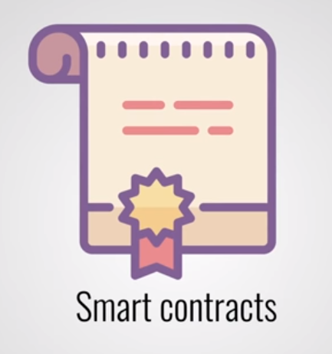
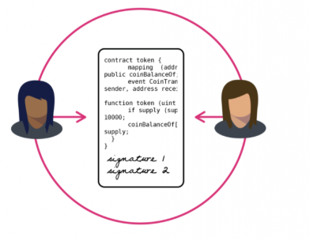
Ethereum smart contracts
Bitcoin has smart contracts but limited to currency use case
Ethereum allows developers to program their own smart contracts
You can see a contract as an abstracted bit of functionality
No best practices
some put all their logic in 1 contract some split it out into many contracts like they would a real-world application
Smart contracts method are given an accessibility level (just like TypeScript and .NET Core). Public, private and external (talk about this more later)
Up to the developer in how decentralised they make it
You can fire events in a contract
Perfect way to catch these events in the frontend
You can make certain methods “payable”
As it says on the tin gas is required to execute it
Stores information about an application
Ethereum have created these contracts which allow complete flexibility in how you use their blockchain
“With power comes great responsibility”
A smart contract can trigger another smart contract and so on…

Slide 19
Ethereum smart contracts
All the rules and penalties are defined by the smart contract
It also enforces them
In theory, whole systems and organizations can run entirely on smart contracts.
This is already happening…
It gives you
Trust
No one can steal or lose any documents as they are encrypted and safely store in a secured shared ledge
Safety
If written contract smart contracts are impossible to hack
Efficiency
Once the contracts are written it will handle any amount of request anywhere in the world
No manual wasting
No paper documents
Savings
Estate agents, advisors, assistance and many other jobs will not be needed thanks to smart contracts
SORRY ☹
Autonomy
Smart contracts do not need third party to complete tasks
This gives full control of the agreement

Slide 20
Cons of Ethereum smart contracts..
Young tech
Prone to problems
The code must have no bugs to perform perfectly
This can lead to money being stolen with no way to get it back
How will the government regulate such contracts
How will they be taxed
Could it be used in court
Would people trust computers to make big deals
Sell their house
Sign contracts
… well people trust computers a lot now!
Mainly unknowns….
With such a new tech you expect this unknowns though
Should be ironed out in time

Slide 21
Solidity
The language you use to write smart contracts
Syntax similar to TypeScript
Very new – only on version 0.5.x now
More work the more gas it costs to run, different approach to programming
Not easy to deploy
Up to you how decentralised you want to make it
Hardly any IntelliSense
Hardly any ability to debug
Anyone can decode your contract quite easily – complete visibility
One mistake in your code and someone could get full control of your contract
I am going to touch on the fundamentals of solidity, this will show you the basic level. Don’t expect to be able to be a full blockchain developer after these slides :D.. This is just the tip of the iceberg trust me!

Slide 22
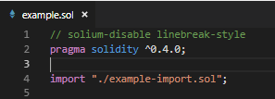
Imports

Slide 23
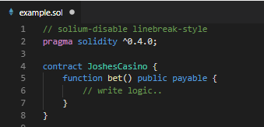
Functions

Slide 24
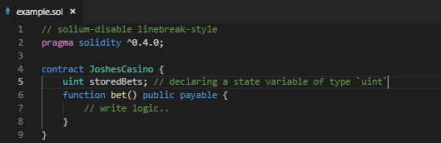
State Variables
Data which is permanently stored in the contract

Slide 25
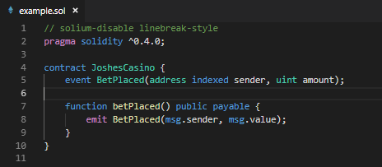
Events
These trigger events to fire which anything can listen to, yes this mean websites etc.

Slide 26
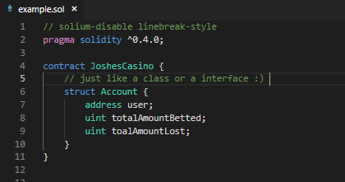
Struct Types
Struct is just like a class or an interface, it is just a set of defined types. These can hold any solidity type in them.

Slide 27
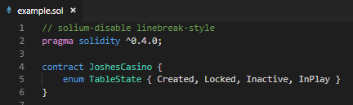
Enums
Custom types with constant values, nowhere near as powerful as .NET or TypeScript enums. It can only be the value of itself, so no string enums or custom values for a type.

Slide 28
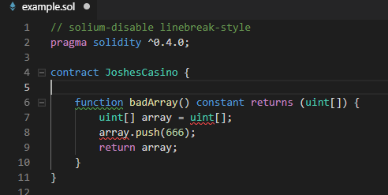
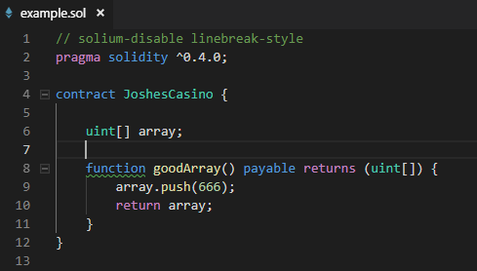
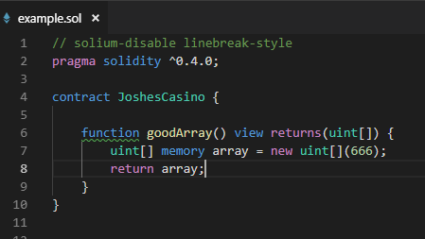
Arrays
Arrays are like TypeScript except any arrays in memory the size of the array must be defined. If you need to use a dynamic size array you then need to use storage to hold it.
WILL COMPILE BUT COST DUE TO CHANGING THE STORAGE DATA
WILL NOT COMPILE
WILL COMPILE AND HOLD THE VALUES IN MEMORY

Slide 29
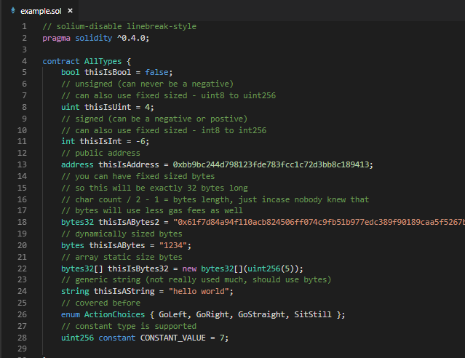
Types

Slide 30
Function types
External functions are part of the contract interface, which means they can be called from other contracts and via transactions. An external function f cannot be called internally (i.e. f()does not work, but this.f() works).
Public functions are part of the contract interface and can be either called internally or via messages.
Internal functions and state variables can only be accessed internally (i.e. from within the current contract or contracts deriving from it)
Private functions and state variables are only visible for the contract they are defined in and not in derived contracts.

Slide 31
Function modifiers
Constant modifier has been deprecated as was to vague, should use view instead
View modifier does not modify any state. Getter methods are a perfect example of view functions, as they are only used to retrieve a value instead of modifying the element. This uses no gas and is free to call.
Pure modifier is similar to view but it can access local variable and can not access the global variable. This is useful for little helper functions which convert types. Again this uses no gas and is free to call.
Payable modifier does what it says on the tin, it allows a function to receive Ethereum while being called. This will cost gas to execute as well. So when you send Ethereum to another wallet the command which it executes is a payable function.
Custom modifier is what it says it is, a custom function modifier written

Slide 32
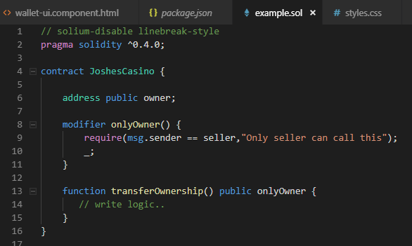
Custom Function Modifiers

Slide 33
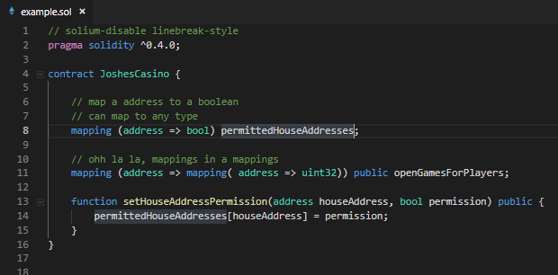
Mappings
A mapping is used to structure value types, such as booleans, integers, addresses, and structs. Allowing you to map values to your type, similar to an Dictionary in .NET. Very powerful and one of the ways you can store data in the contract.

Slide 34
Ethereum VM
The Ethereum Virtual Machine has three areas where it can store items.
Storage - where all the contract state variables reside. Every contract has its own storage and it is persistent between function calls and quite expensive to use.
Memory - this is used to hold temporary values. It is erased between (external) function calls and is cheaper to use.
Stack - which is used to hold small local variables. It is almost free to use, but can only hold a limited amount of values.

Slide 35
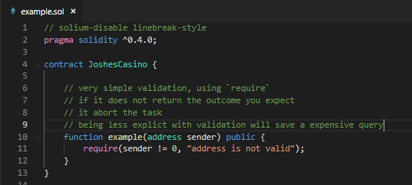
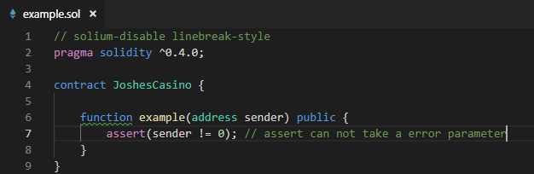
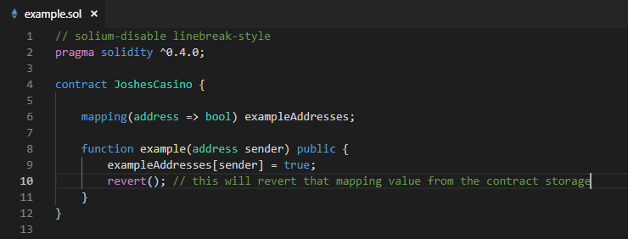
Error handling
The more complex the function the more expensive it cost to run
you want to make it as cheap to execute as possible.
You must take a different approach when building these functions to when developing a typical project.
Catching exceptions is not yet possible
Require
Should be used to ensure valid conditions from inputs, state variables or return values from calls to external contracts
Assert
Should only be used to test for internal errors
Revert
Used to flag an error and revert the current call

Slide 36
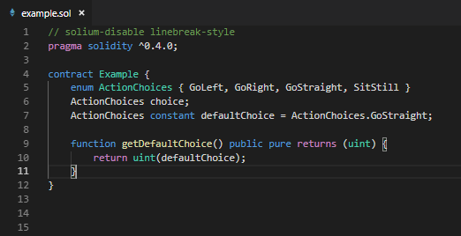
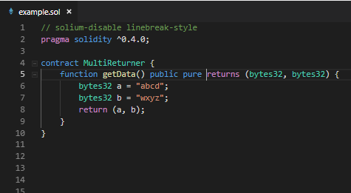
Returns
Simple syntax, declaring what is being returned in the function, this can handle multiple return values.

Slide 37
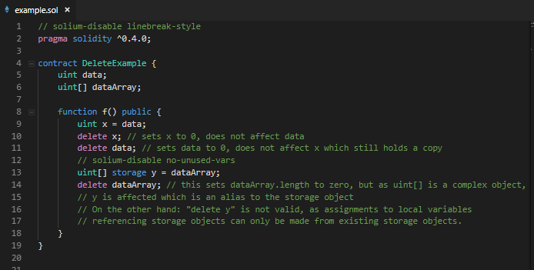
Delete keyword

Slide 38
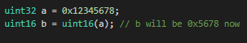
Conversions
Solidity conversions differ a little from standard programming conversion. If you convert a bigger sized byte, int etc to a smaller sized type it will still do that conversation but cut off certain higher-order values, so it can fit into the sized type.

Slide 39
Control Structures
Built in control structures very similar to JavaScript
If statement – no type conversion so `if(1) {}` is not valid in solidity
else statement
while
do
for
break
continue
return
return (v0, v1….., v6) – a function can return multiple as explained earlier
:
?

Slide 40
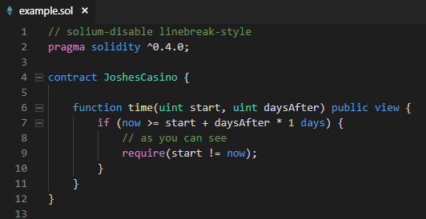
Time units
now – uint as it says on the tin
1 == 1 seconds
1 minutes == 60 seconds
1 hours == 60 minutes
1 days == 24 hours
1 weeks == 7 days
1 years == 365 days

Slide 41
Special built in function
gasLeft() – returns uint256 = remaining gas
msg.sender – returns address = sender of the message
msg.value – returns uint – number of wei sent with the message
tx.gasprice – returns uint – gas price of transaction
block.number = returns uint – current block number
block.timestamp = returns uint – block timestamp as seconds epoch
block.coinbase – returns address – miners address
block.gaslimit – returns uint – current block gaslimit
Also a few `abi.encode..` - out of scope of talk
MANY MORE ☺

Slide 42
Built in Address functions
<address>.balance – returns uint256 – balance of address
<address>.send(uint256 amount) – returns bool – send given amount
<address>.call(..) – returns bool – call bespoke method for a contract
A few more but out of scope..

Slide 43
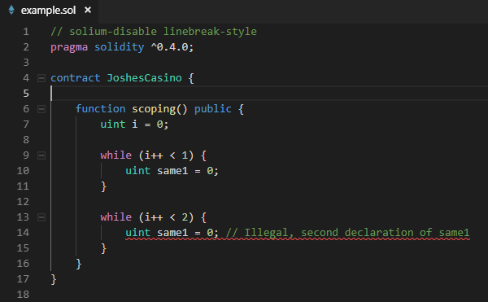
Scoping and declaration
Since < 0.5 scoping was within the entire function
0.5 experimental version scoping is trying to resolve this, so it becomes what a `let` is in JavaScript

Slide 44
Please get involved with the crypto movement. If this is something which interests you then dive in and join the community. Any open source projects you can create or contribute to would be amazing! Lets make this space take over… ☺
THANKS FOR LISTENING!!
Any questions are welcome..

